Slide 1



Gandaki College of Engineering and Science
Nov, 2025
SMARTRESELL– YOUR TRUSTED MARKETPLACE FOR SECOND HAND MOBILE PHONES
Presentation by
Bhawana KC
Kabita Adhikari
Prasamsha Tripathi

Slide 2
OVERVIEW
Introduction
Data Description
Equation Optain
01
11
05
Problem Statement
Exploratory Data Analysis
06
Use Case Diagram
12
02
Objectives
03
Algorithm Used
09
ER Diagram
13
Required Tools
04
Evaluation Matrix
10
Conclusion
14
Future Work
15

Slide 3

INTRODUCTION
  SmartResell is a web platform for buying and selling second-hand iPhones.
  It provides easy listing and price prediction.
  Why we need SmartResell?
    Ensures fair pricing and reliable marketplace.
    Efficient management of mobile listings.
Page 1

Slide 4
PROBLEM STATEMENT
  Problems in Current Mobile Marketplaces:
    Unfair pricing: Sellers often set prices too high or too low due to lack of data-driven tools.
    Inefficient communication: Buyer-seller interactions are slow and unclear.
Page 2

Slide 5
OBJECTIVE
  Develop a web platform for buying and selling second-hand mobile phones.
  Implement a price prediction system to help sellers set fair prices.
  Enable buyers to find reasonably priced devices easily.
Page 3

Slide 6
REQUIRED TOOLS
The following tools are used for development of this project:
  For UI/UX: HTML, CSS, JavaScript, Bootstrap
  For backend: PHP
  Database: MySQL
  For UML diagrams and wireframes: Draw.io
  Machine Learning: Python(Scikit-learn)
  Web Scraping: BeautifulSoup
  For Documentation: Office Package
  For version control and collaboration: Git and GitHub
  For coding: Visual Studio Code
Page 5

Slide 7

DATA DESCRIPTION
Data Size: 2,000 iPhone listings
Source: Hamrobazar (Nepal)
Key Attributes: Model, RAM, Storage, Battery Capacity, Used Months, Battery Health, Price
Sample Data:
model | RAM | storage | battery_capacity | used_months | battery_health | price
iPhone 8 | 1821 | 2 | 64 | 2017 | 98 | 85
iPhone 16 | 3561 | 8 | 128 | 2024 | 14 | 61
iPhone 11 | 3110 | 4 | 64 | 2019 | 74 | 99
Page 5

Slide 8
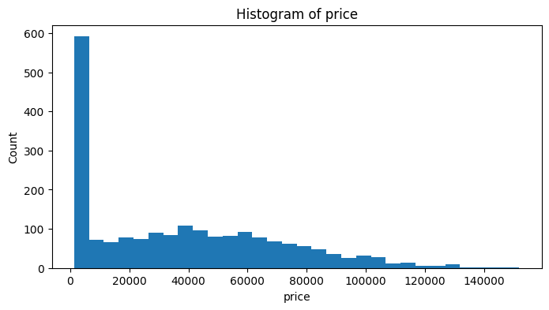
EXPLORATORY DATA ANALYSIS (EDA)
1. Data Visualization
Histogram of price:
Page 6

Slide 9
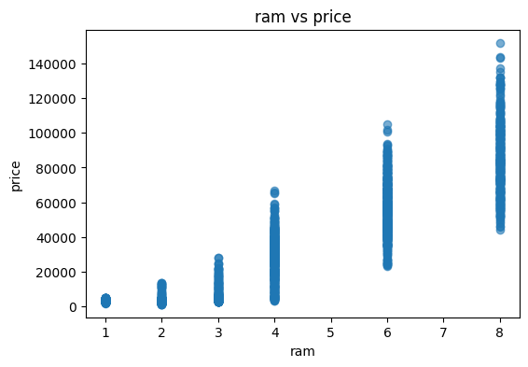
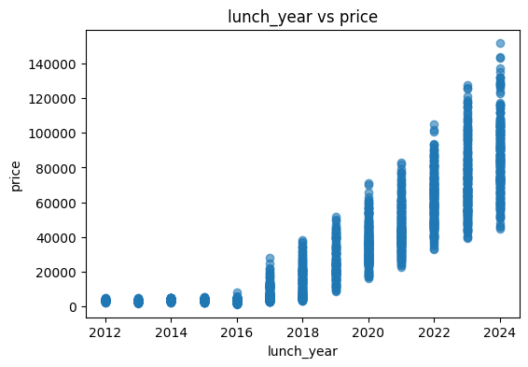
Scatter Plot
ram vs price launch_year vs price
Page 7

Slide 10
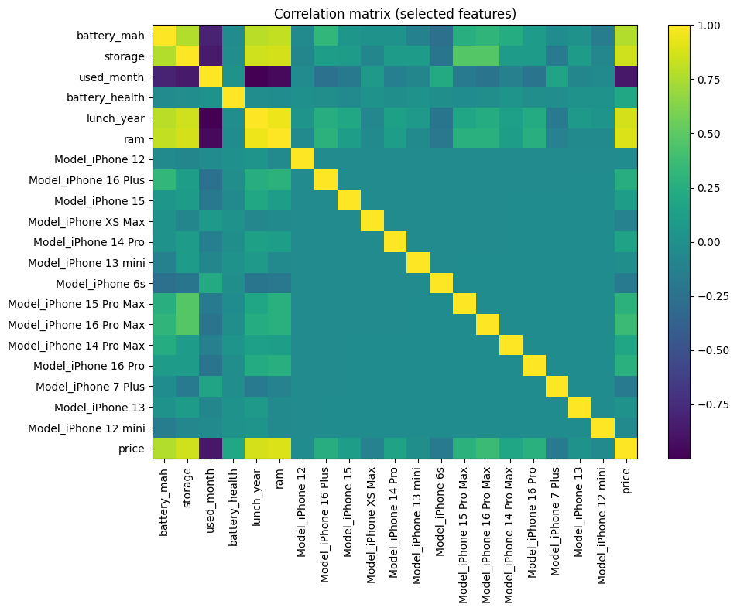
2. Correlation Analysis
Page 8

Slide 11
ALGORITHM USED
Linear Regression:
Predicts iPhone resale price based on features.
Features used: Model, RAM, Storage, Battery Capacity, Used Months, Battery Health.
Why used: Simple, interpretable, effective for predicting continuous values.
Page 9

Slide 12
EVALUATION MATRIX
Metrics:
  R² Score: How well the model predicts price compared to actual values.
  Mean Absolute Error (MAE): Average absolute difference between predicted and actual prices.
  Root Mean Squared Error (RMSE): Penalizes larger errors more heavily.
Metrics | Value
R² Score | 0.9445724622843367
Mean Absolute Error (MAE) | 6200.489663442336
Root Mean Squared Error (RMSE) | 8064.525091440642
Page 10

Slide 13
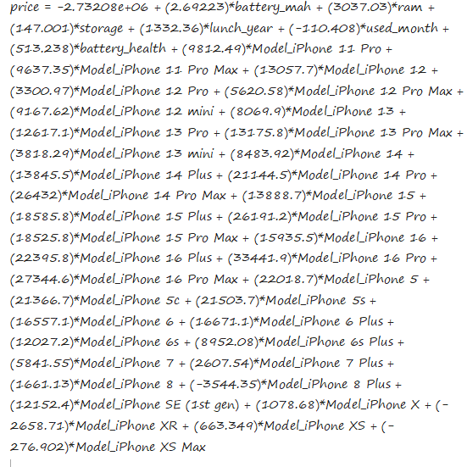
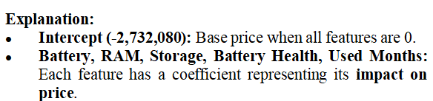
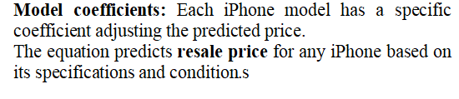
EQUATION OPTAIN
Price Prediction Equation (Linear Regression):

Slide 14
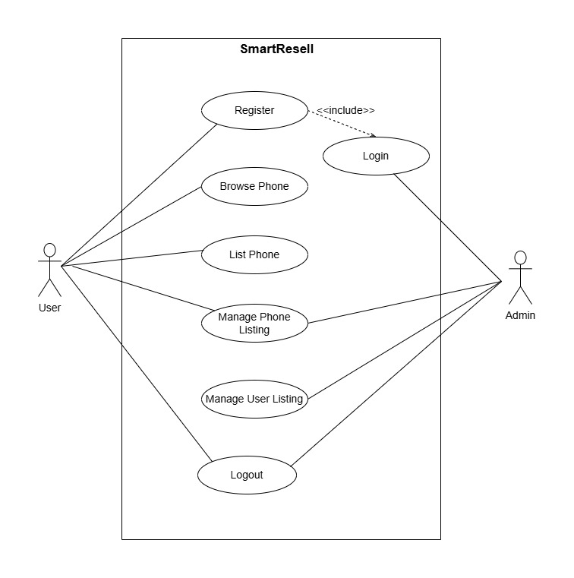
USE CASE DIAGRAM

Slide 15
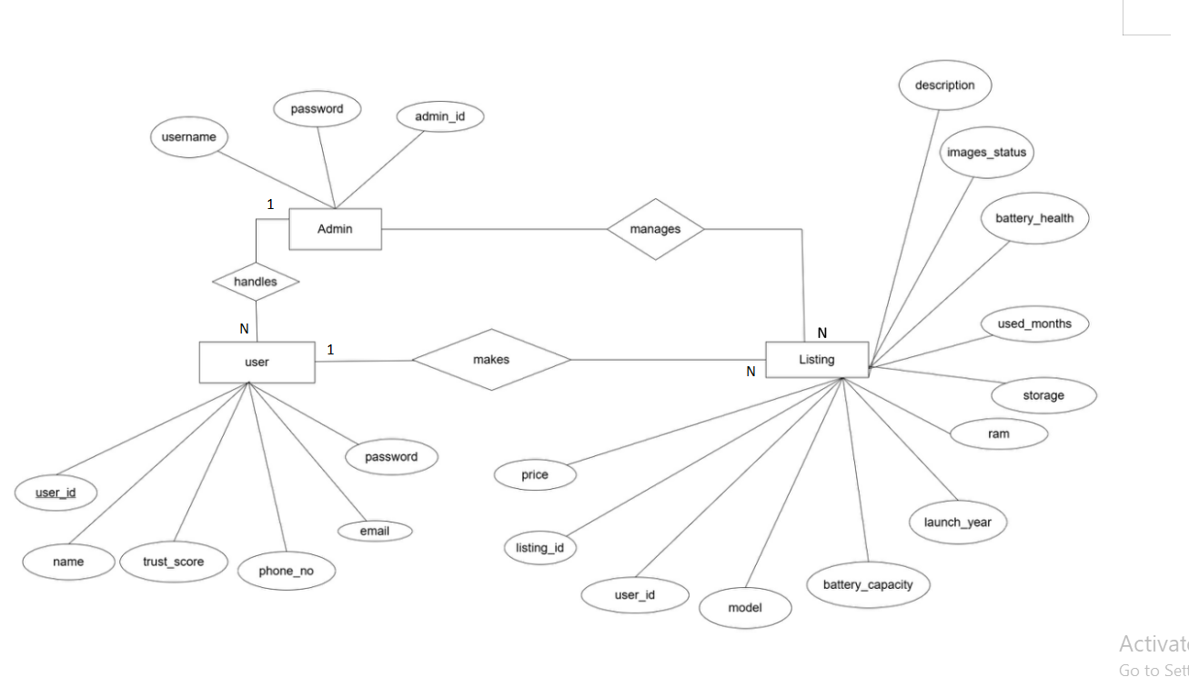
ER DIAGRAM

Slide 16
CONCLUSION
We have successfully developed a web platform for buying and selling second-hand mobile phones.
The trained model generated a formula that accurately predicts fair resale prices for listed devices.
Overall, the project met all its objectives and provides a strong foundation for future enhancement and scalability.
Page 14

Slide 17
FUTURE WORK
Collect larger dataset for improved model accuracy. 
Extend to other mobile brands.
Page 15

Slide 18
THANK YOU

